Slide 1
120,000 Free Lesson Plans in Less Than an Hour!
NNCSS Conference 2018
Karen Karst-Hoskins and Nancy Maldonado
Notes:
Welcome to “120,000 Free Lesson Plans in Less Than an Hour!” Introduction of Karen Karst-Hoskins and Nancy Maldonado.

Slide 2
Objectives:
Introduce K-12 Social Studies teachers to PBS LearningMedia through an interactive hands-on presentation in a computer lab setting.
All attendees will sign up as a user and have an understanding of how to search topics, grade levels, and standards in order to use PBS Learning Media effectively in their classroom.
Notes:
Review objectives for this presentation.

Slide 3
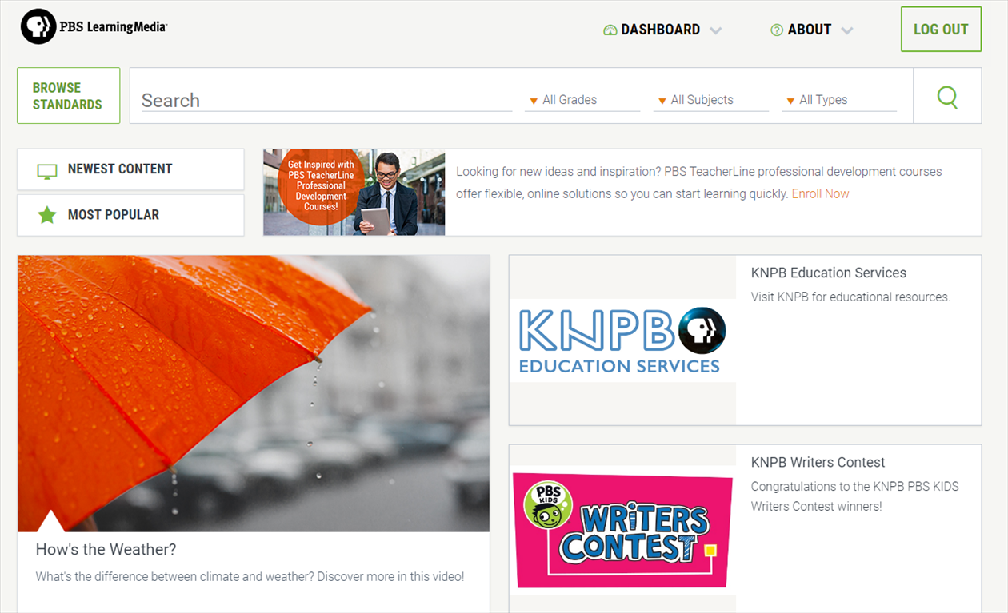
How Teachers Use PBS LearningMedia
Notes:
Provide background information on PBS LearningMedia.
PBS is a leading source of digital learning tools for grades PreK-12 classrooms – the gateway for educators to access these resources is through PBS LearningMedia.
PBS LearningMedia’s 120,000+ resources span a range of media types – videos, lesson plans, interactive games, audio clips, and documents.

Slide 4
Award Winning Content
Content drawn from critically acclaimed PBS programs such as:
NOVA
FRONTLINE
NATURE
and PBS KIDS programs like WILD KRATTS
The Library of Congress and even
NASA!
More content is added all of the time!
Notes:
Featuring trusted educational media producers.

Slide 5
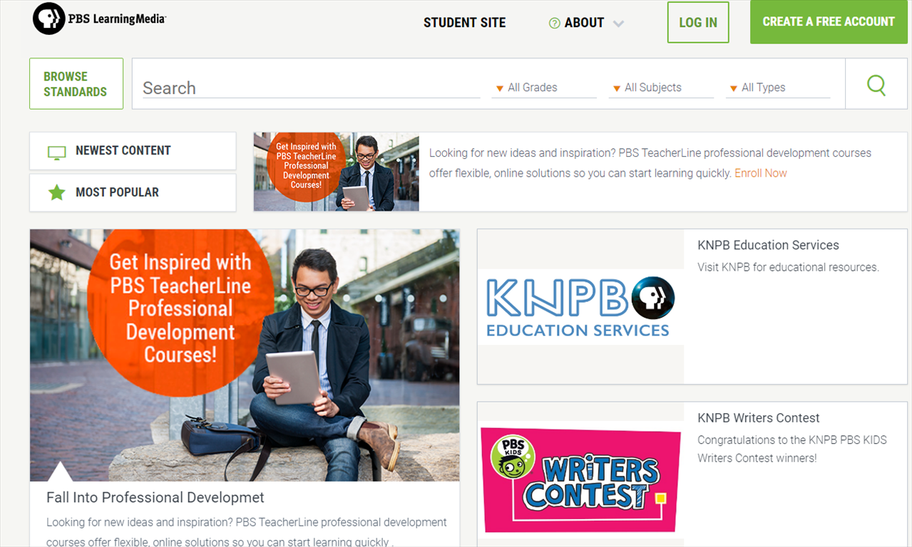
Notes:
On your own computer go to www.pbslearningmedia.org
Upon visiting PBS LearningMedia for the first time, you will be able to register for a free account via the green button on the top right-hand side of the page.

Slide 6
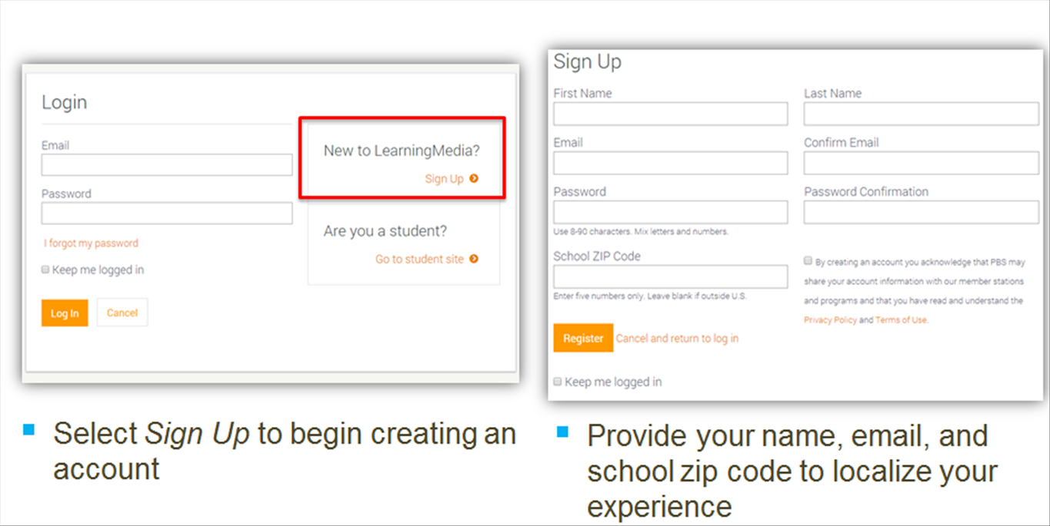
Notes:
After selecting “Sign Up,” users will be prompted to provide their name, email, and school’s zip code and will be able to create a password. Information is collected from users to help personalize and localize their experience. By providing your local zip code when creating your profile, you will be directed to your local site.

Slide 7
Homepage Features
Notes:
Homepage Features:
Options at the top of the page allow users to conduct searches by grade and subject, standards-alignment, type of media, or keyword.
The feature well in the center of the page is updated frequently to reflect weekly content themes and news and events.
At the top of the homepage, users can access their personalized Dashboard to view their favorites, update their profile, and use the productivity tools.
Tools include accessing storyboard, quiz maker, and lesson builder tools.

Slide 8
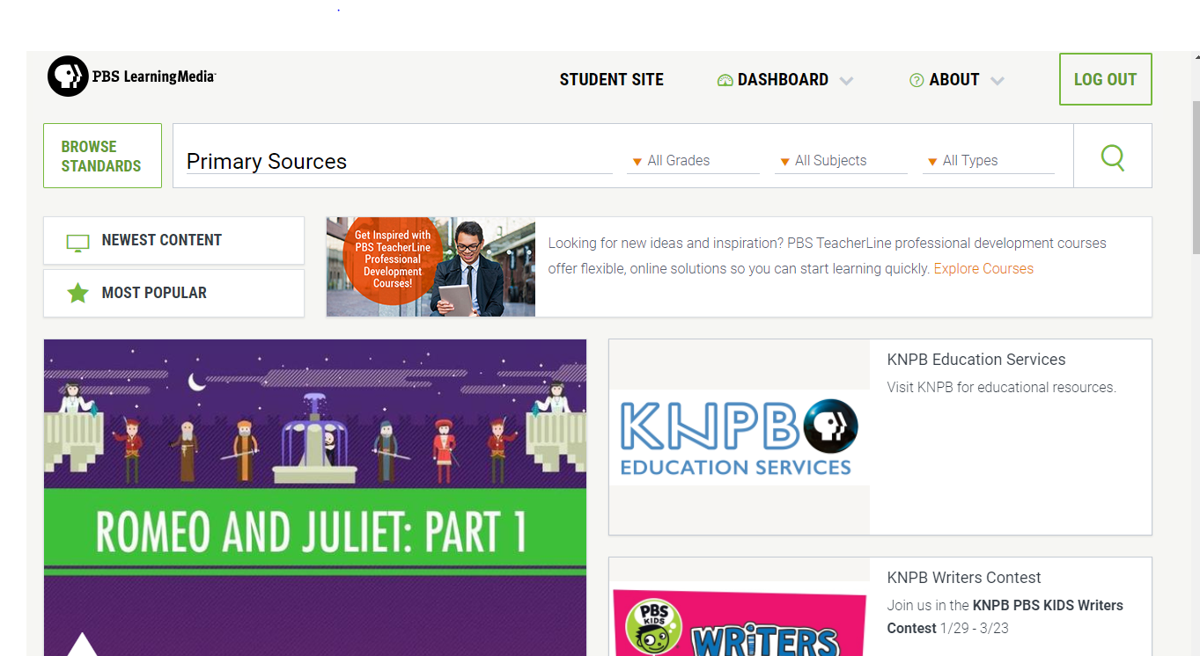
Notes:
Before I let you explore this website on your own, I’m going to show you a few of my favorite resources/collections.
Type “Primary Sources” into Search

Slide 9
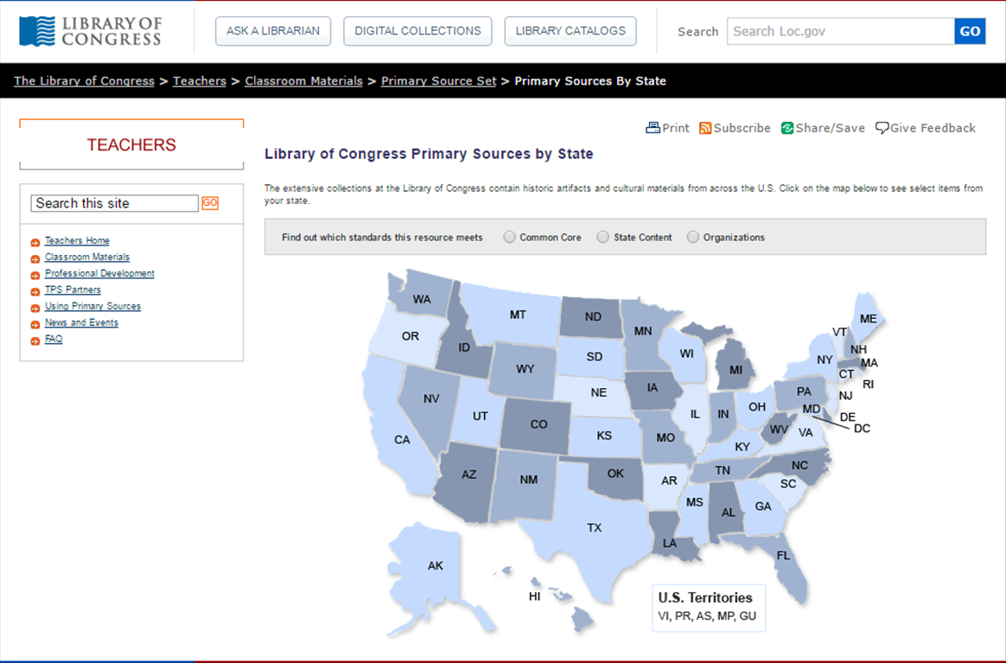
Notes:
Primary Sources by State. This presentation uses Library of Congress primary sources to categorize collection items by state.

Slide 10
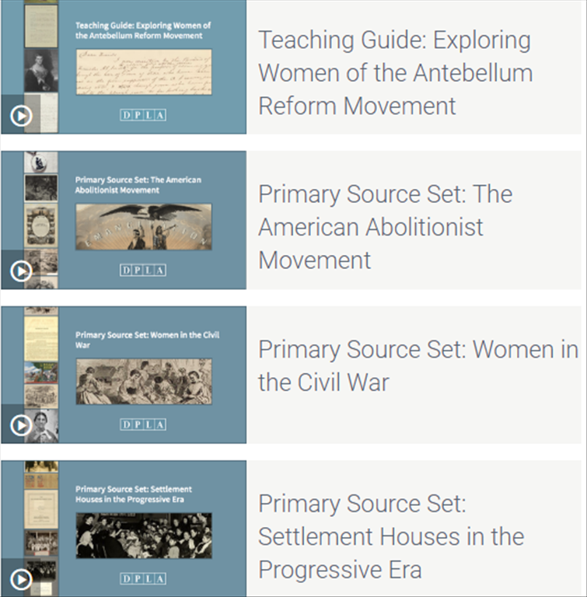
Browse by topic:
Primary Source Sets
US History
American Literature
Science and Technology
World History
Arts
African Americans
Asian Americans
Labor History
Latino Americans
Law & Government
Migration
Native
Americans
Social Movements
Women
Notes:
(Search: DPLA Primary Sources Collection)
Digital Public Library of America (DPLA) Primary Source Sets are designed to help students develop critical thinking skills by exploring topics in history, literature, and culture through primary sources.
Drawing online materials from libraries, archives, and museums across the United States, the sets use letters, photographs, posters, oral histories, video clips, sheet music, and more.
Each set includes a topic overview, ten to fifteen primary sources, links to related resources, and a teaching guide.
These sets were created and reviewed by the teachers on the DPLA's Education Advisory Committee.

Slide 11
Notes:
(Search: National Archives)
PBS LearningMedia contains primary documents through the National Archives . Access the online tool Docs Teach for teaching with documents as presented from the National Archives.

Slide 12
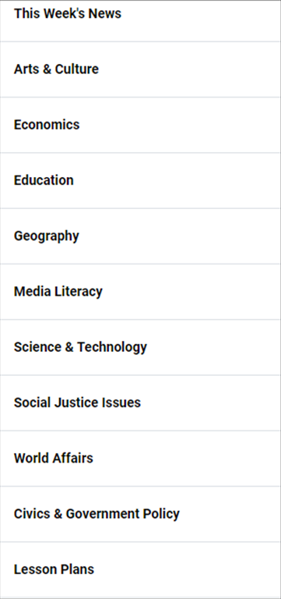
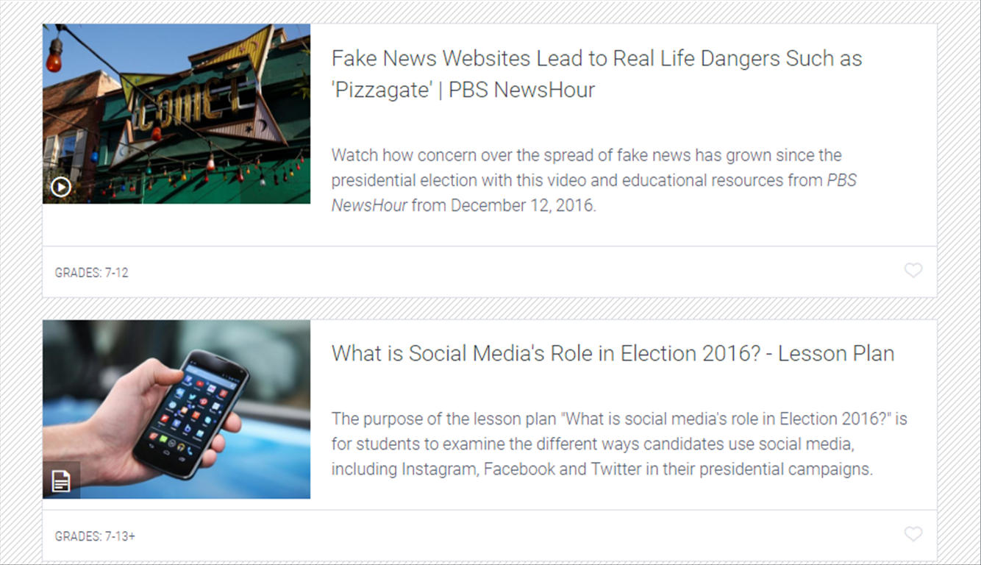
Notes:
(Search: PBS Newshour Daily News Story)
PBS NewsHour Extra helps teachers and students identify the who, what, when, where and why-it-matters of major national and international news stories.
In partnership with PBS LearningMedia, we are proud to bring you the Daily News Story which takes the best of the PBS NewsHour news program and pairs it with discussion questions, lesson plans and stories developed specifically for students.
Our lesson plans and resources help achieve Common Core State Standards goals and cover core academic subject areas ranging from civics and government to world affairs and education.

Slide 13
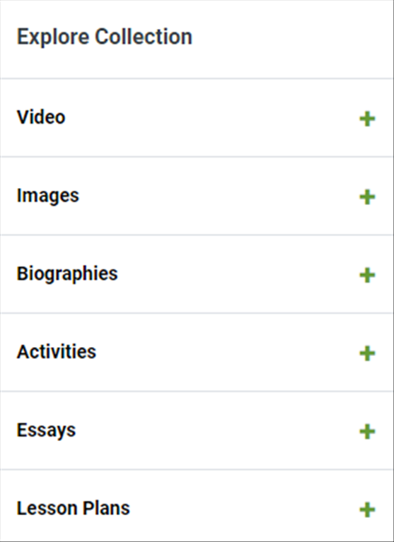
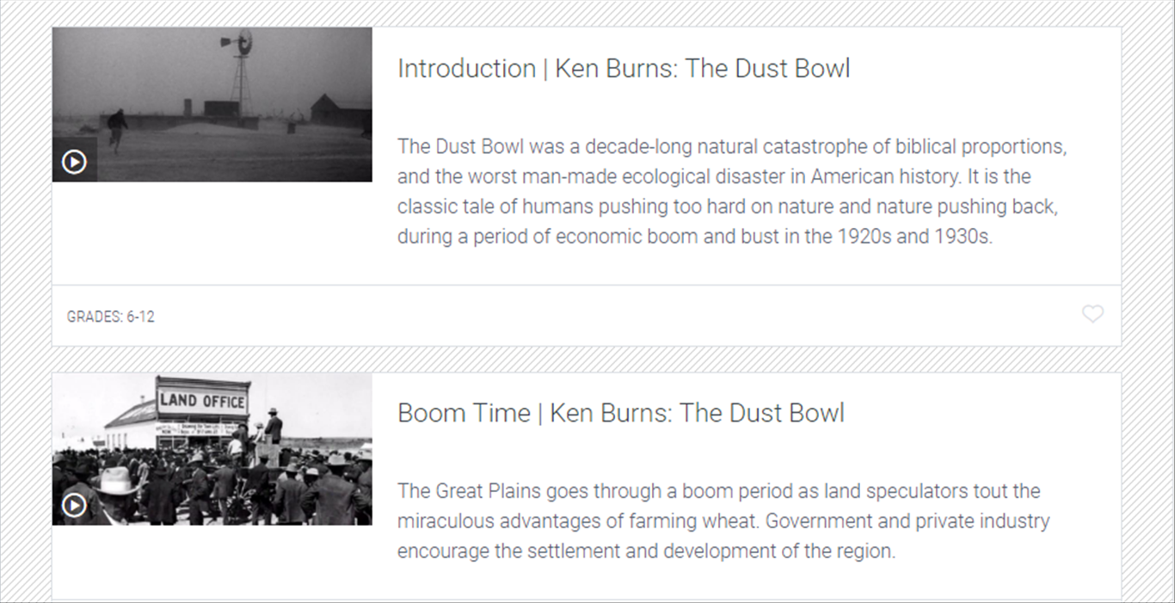
Notes:
(Search: Ken Burns Collection)
This collection highlights many of Burns' great works, exploring topics from war to politics to the history of baseball.
His films tell the story of people who have overcome adversity and have made impacts on our nation.
Use these resources to engage students with different ways of exploring key historical events and personal stories.
These resources highlight important themes, such as capitalism, civil rights, immigration, war, and international relations. Students can investigate and analyze questions of justice, the ingenuity of the U.S., and civic responsibility, and connect history to current events.

Slide 14
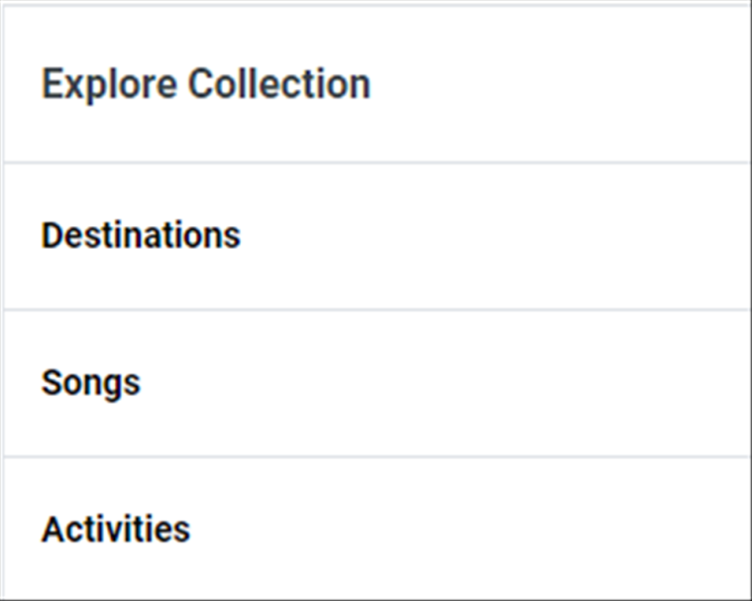
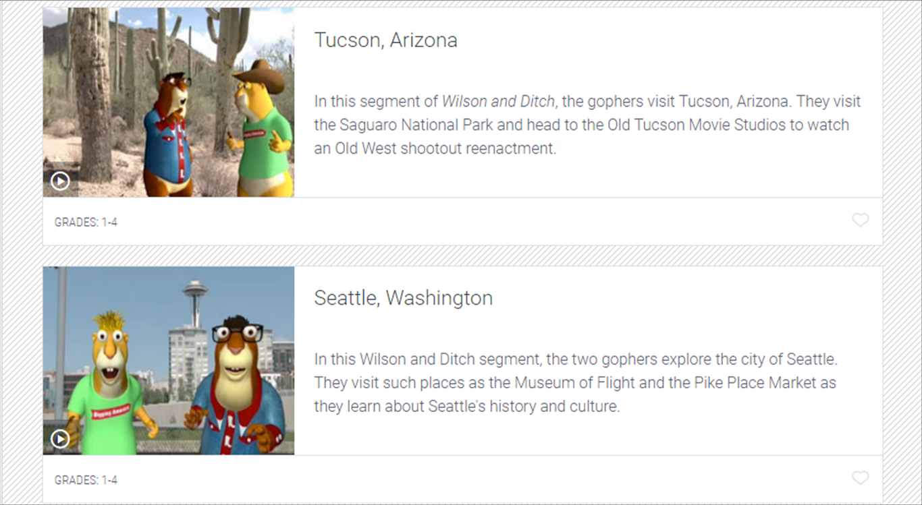
Notes:
(Search: Wilson and Ditch Collection)
Meet Wilson and Ditch, two funny, energetic and talkative gopher brothers, who are in a van – an eco-powered one - and driving around America. Wilson, the older brother, loves learning and teaching facts and reading about each new locale they travel to. He always drives the van while Ditch, the younger more fun-seeking brother who loves to relax and eat, is the permanent passenger. These gopher brothers drive from city to city as tourists who learn the history, "actual facts" (as Wilson calls them), and fun facts of every new location. The brothers also love experiencing the usual touristy stuff as well as the really unusual, obscure, and sometimes just weird sites each city has to offer. Join Wilson and Ditch and DIG AMERICA with them!

Slide 15
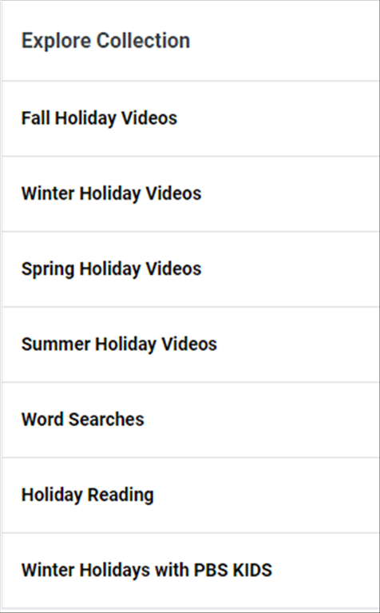
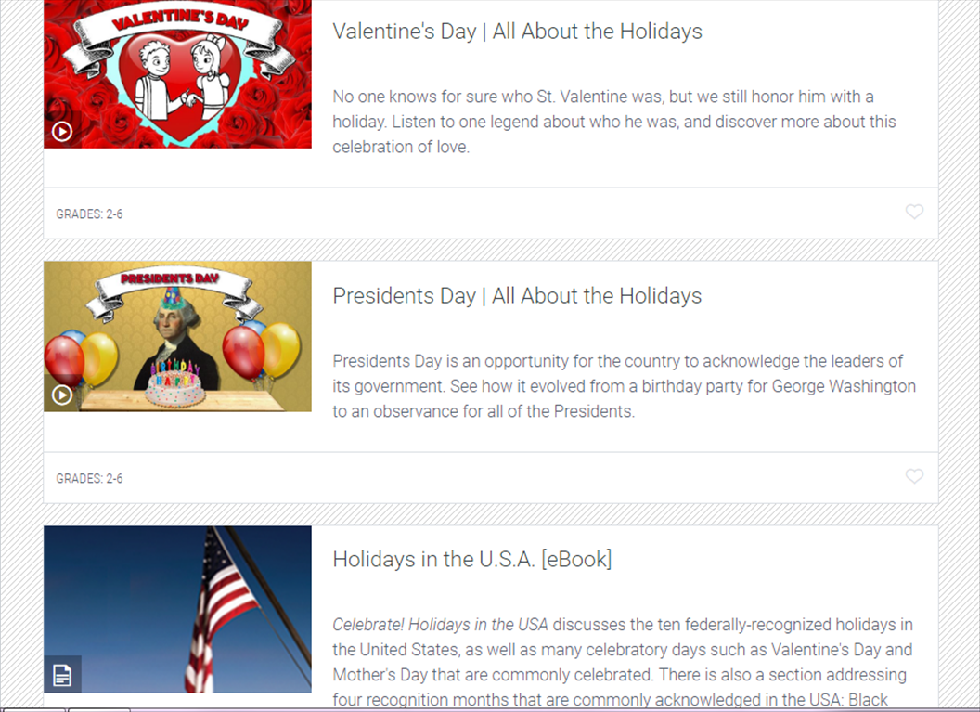
Notes:
(Search: Holiday Collections)
Get to know the history and significance behind these U.S. holidays (and more!) by bringing the holidays into your classroom with PBS LearningMedia's festive Holiday Collection! These curriculum-aligned resources offer historical perspectives on familiar traditions like lighting candles, decorating trees, and giving gifts. This collection also features PBS KIDS content about snow, celebrations and friendship.

Slide 16
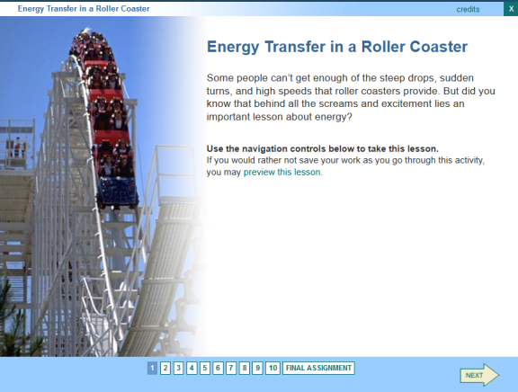
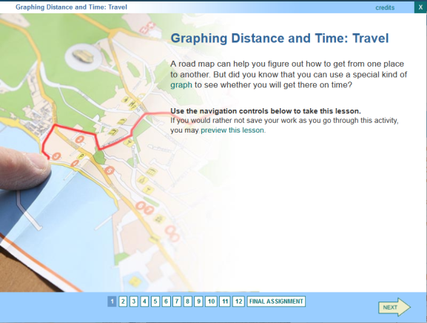
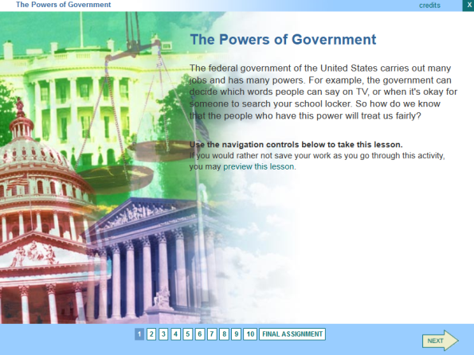
Science
English Language Arts
Social Studies
Mathematics
Notes:
(Search: Inspiring Middle School Literacy Collection)
The ELA Common Core State Standards now focus on reading and writing in the content areas in addition to the more traditional literature and informational text. These standards also support the use of video and other media as text type. Inspiring Middle School Literacy is a collection of self-paced literacy lessons designed for students in 5-8th grades.
These 40 blended literacy lessons require the use of multiple comprehension strategies to read, interpret, and respond to text before, during, and after reading. A teacher guide accompanies each lesson.

Slide 17
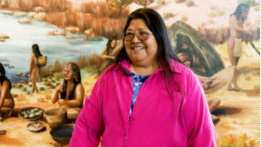
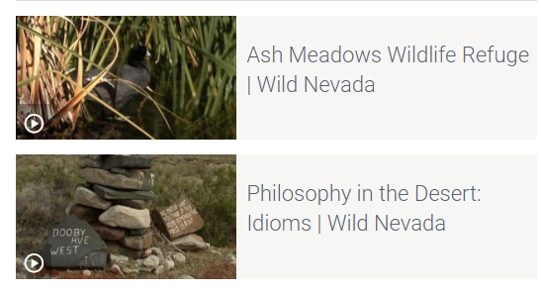
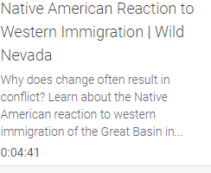
Leah Brady Great Grandfather's Story
Notes:
(Search: Wild Nevada)
Northern Nevada’s most popular travel series, Wild Nevada, provides one of-a-kind educational opportunities. Our Wild Nevada curriculum selection is growing. We are almost ready to form a collection! Each lesson has video clips from the Wild Nevada series and is aligned with Common Core and the new NVACS-SS standards. These lessons follow the inquiry approach and will immerse your students in Nevada’s cultural and natural history.

Slide 18
KNPB.org Website
Notes:
Search: KNPB.org for information about all that KNPB Education Services has to offer.

Slide 19
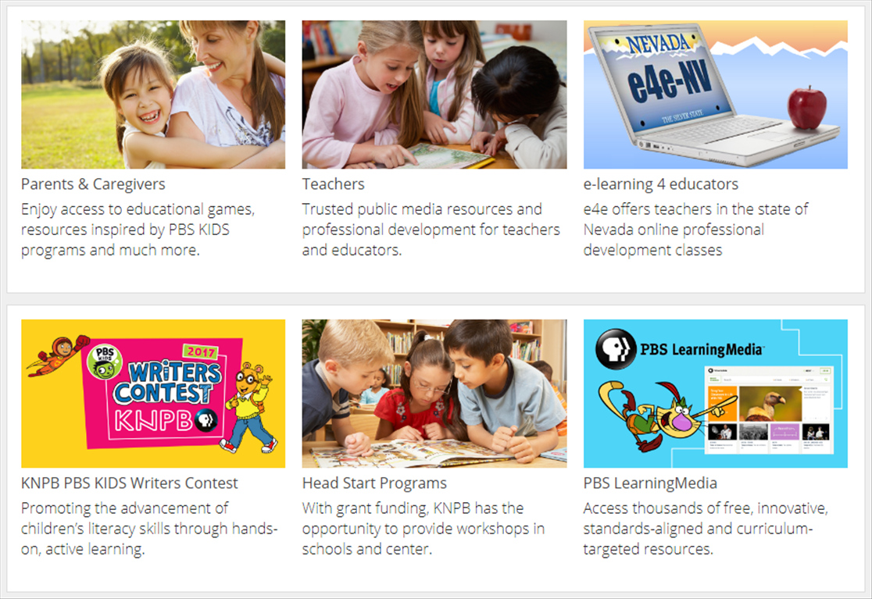
Notes:
KNPB Education Services provides parents, teachers, and students with a variety of resources.

Slide 20
How to Contact Us
Need help?
Contact
Nancy Maldonado
Vice President of
Education Services
775.682.7917
Notes:
Please contact me with any questions or suggestions.
I’d love to hear from you!

