Slide 1
Discussion in a single day?
Pro Se Court
Denise Coverley-Paxton
Dpaxton@washoeschools.net

Slide 2
How We Learn
10% of what we READ
20% of what we HEAR
30% of what we SEE
50% of what we SEE and HEAR
70% of what is DISCUSSED with OTHERS
80% of what is EXPERIENCED PERSONALLY
95% of what we TEACH TO SOMEONE ELSE
William Glasser

Slide 3
Your Classroom?
Where is the majority of learning happening in your classroom?

Slide 4
Why Discussion?
Engage students actively
Involves students cooperatively
Facilitates critical thinking
Involves Accountable Talk
Develops ethics
Text based evidence
Encourages socializing intelligence
Focus on Metacognitive
COMMON CORE

Slide 5
Benefits for Special Student Populations
Less stressful to speak in group of three.
Confidence after preparing with a group.
Peer modeling of reading comprehension
Promotes equity and empowerment

Slide 6
Pro Se Court
Pro se is a Latin phrase meaning "for oneself" or "on one's own behalf".
Triad Discussion model where each student has a role within the triad.
Supreme Court Cases/Lower Court Cases/Multiple Perspective Topics

Slide 7
Preparing A Pro Se Court Discussion
Use your Nevada Academic Content Standards.
Find an interesting topic or case
Court Case=Search for a summary of the case
Topic=Search for a summary of the topic/event
Summary must show opposing sides/views.
Excerpt it, reading level of your students
Copy text and Pro Se Court Resource Page for each student.

Slide 8
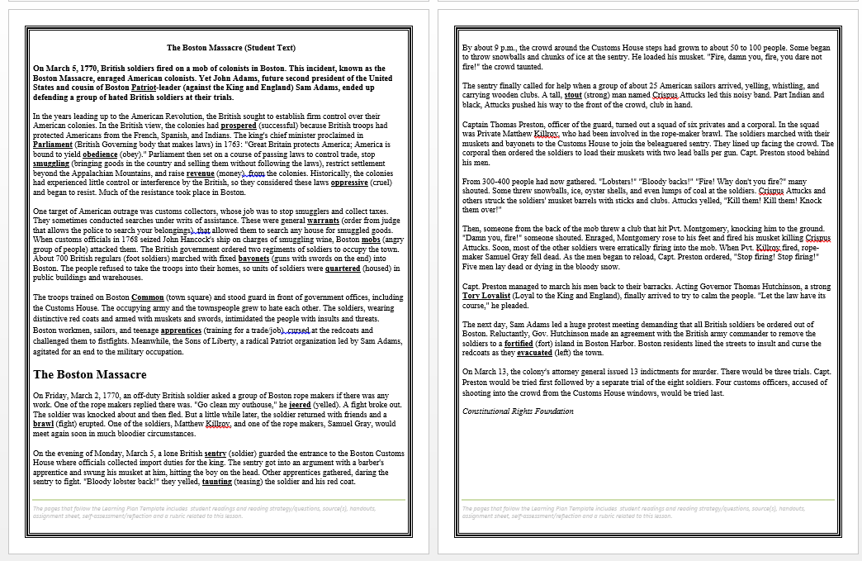
Boston Massacre

Slide 9
Prepare for Court
Share the background (excerpt) of the case with the students, check for understanding of the issues, ask questions to see if students see multiple perspectives.
(Depending on the purpose of the text, students may read the text on their own and annotate)
Split students into three heterogeneous group ( 1s petition, 2s respondent, 3s justice)
Students move to form three groups.
Students work together in their groups to complete the Collaborative Group Notes. Must collect notes based on the side they are representing (not their personal view of the issue). Judges will collect notes on both sides of the issue. (10 min.)
Group fills out Pro Se Court side of the note taker. They decide the three best pieces of evidence to prove/persuade their case. All students in the group have the same notes and evidence ready to present. Justices write one question they would like to ask each side. (10 min.)
Explain the workings of a courtroom; courtroom etiquette

Slide 10
Pro Se Court Discussion
Have the justices stand against a wall.
Arrange desks or chairs into triads.
Tell the Petitioners to take a seat, 1 per triad. Tell the Respondents to join a Petitioner. Sit side by side.
“All rise.” Justices take a seat at each triad.
“Court is now in session. (insert case name).”
Petitioner has 1 minute to present case. Respondent and Justice filling out Case Sheet. Justice ask questions.
Respondent has 1 minute to present case. Petitioner and Justice fill out Case Sheet. Justices ask questions.
J
P
R

Slide 11
Pro Se Court Cont.
Petitioners have 30 seconds for rebuttal. Respondents have 30 seconds for rebuttal.
Silent as the Justices write down their decision and reasoning-evidence presented. When finished, stand up quietly. When all the Justices are standing, have them read their decision to the class and record their decisions on the board, tallies.
Read the result of the actual case and debrief.

Slide 12
Outcome
After deliberating for about three hours, the jurors found all the soldiers innocent of murder, but judged Pvts. Montgomery and Killroy guilty of manslaughter. Although these men were technically convicted of a capital offense, the court permitted them to make a special plea that reduced their penalty to branding on the thumb. Montgomery later admitted that it was he who had shouted, “Damn you, fire!” just before he shot his musket.

Slide 13
Argumentative Writing
Students write an argumentative paragraph on whether they agree or disagree with the court’s decision. Students must state a claim, use evidence from the discussion and explain with reasoning.

Slide 14
How can you apply this discussion in your own classroom?
Example Topics:
Donner Party—Hasting Cutoff
Trail of Tears
Boom or Bust?
The Code of Hammurabi
Indian Removal Act
Repartitions for Slavery
Executive Order 9066
Scopes Money Trial—Science—Evolution

Slide 15
Our Students, Our Future Leaders

Slide 16
Thoughts To Ponder
Tell me,
I forget.
Show me,
I remember.
Involve me,
I understand.

