Slide 1
World War I: War or Not?
World War I DBQ--Counterclaim

Slide 2
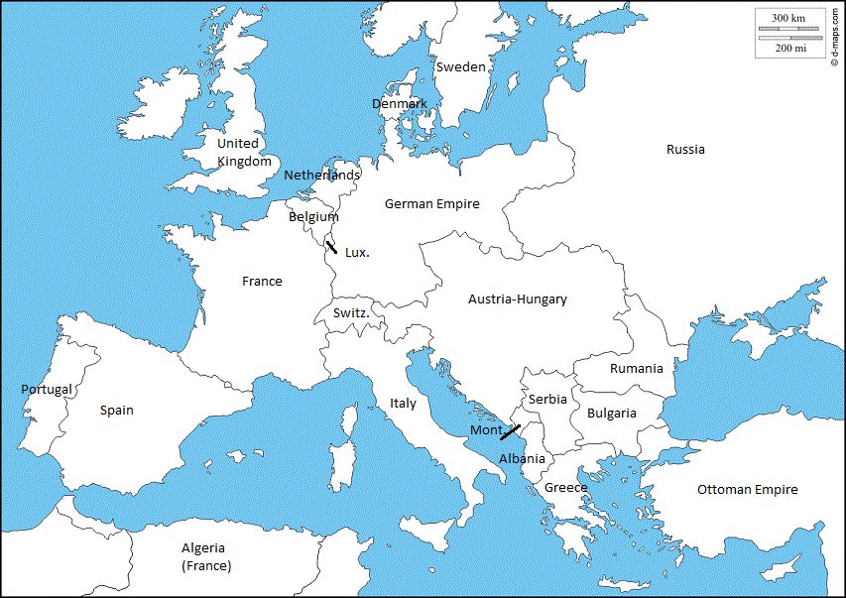
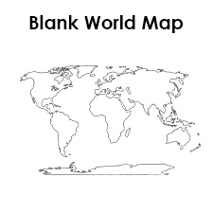
World War I: Domino Effect
June 28, 1914—Serb nationalist assassinated the nephew of Austria-Hungary’s emperor.
One month later, Austria-Hungary declared war on Serbia.
Russia and France mobilized their armies to assist Serbia.
Germany demanded Russia and France to demobilize. They refused.
Germany, Austria-Hungary’s ally, invaded Belgium to bypass several French Forts.
Create a Flow chart showing the Domino Effect following the assassination.
Notes:
NOTICE-NOTE-Question, Listen to the background about the history of World War I, write at least two details that you want to remember, discuss with a partner a question you have.

Slide 3
World War I: Domino Effect
Britain, Belgium’s ally, declared war on Germany
British and German blockade of each other ports
British surface ships
German U-boats, submarines, and sunk ships without warning
Germany warned American ships before sinking, but on February 1, 1917, Germany ended this policy
Create a Flow chart showing the Domino Effect following the assassination.
Notes:
NOTICE-NOTE-Question, Listen to the background about the history of World War I, write at least two details that you want to remember, discuss with a partner a question you have.

Slide 4
Lusitania Warning
Doc. A
“Travelers intending to embark on the Lusitania’s Atlantic voyage are reminded that a state of war exists between Germany and her allies and Great Britain and her allies: that a zone of war includes the waters adjacent to the British Isles; that, in accordance with formal notice given by the Imperial German Government, vessels flying the flag of Great Britain or of any of her allies, are liable to destruction in those waters and that travelers sailing in the war zone on ships of Great Britain or her allies do so at their own risk. –German advertisement in the New York Herald, May 1, 1915
List three pieces of evidence that supports that Americans were warned.
Notes:
NOTICE—NOTE—QUESTION– write at least two details you want to remember. What questions do you have?

Slide 5
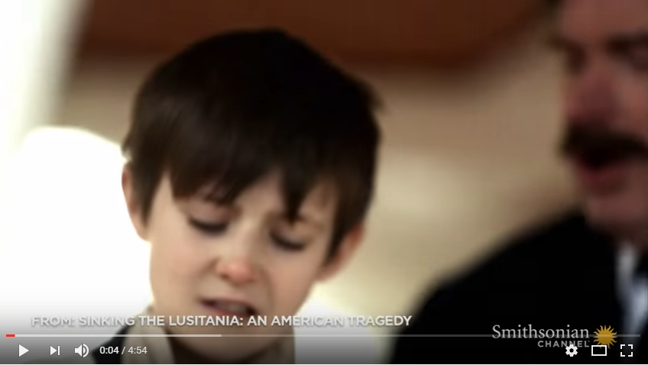
Lusitania Attack
Doc B
List three pieces of evidence that supports that Americans were attacked.
Notes:
NOTICE—NOTE—QUESTION– write at least two details you want to remember. What questions do you have?

Slide 6
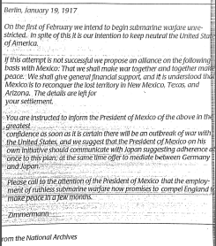
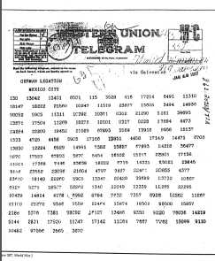
Zimmerman Note
Doc. C
Notes:
NOTICE—NOTE—QUESTION—write down 2 ideas you want to remember. What questions do you have? Share with a partner, Why is the German Government writing to the President of Mexico? Explain the evidence through reasoning why Mexico should join an alliance with Germany .

Slide 7
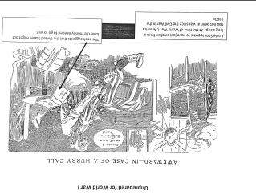
Doc. D
Notes:
NOTICE—NOTE—QUESTION—write down 2 ideas you want to remember. What questions do you have? Share with a partner, List 5 pieces of evidence from the political cartoon (What I See), Create a claim using at least two pieces of evidence (What I Think), Explain your evidence—How does your evidence prove your claim—how? Why? “How I Know”

Slide 8
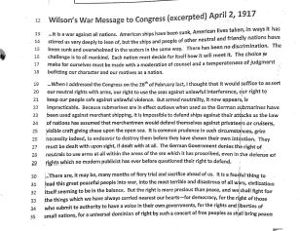
Document E Congressional Hearing
You are President Wilson testifying before Congress. You are asking Congress to declare
War on Germany.
Choose the strongest 2 pieces of evidence to persuade Congress to declare war.
Notes:
NOTICE—NOTE—QUESTION—Write down one detail you want to remember from Document E—Choose the two best pieces of evidence to persuade Congress to declare war.

Slide 9
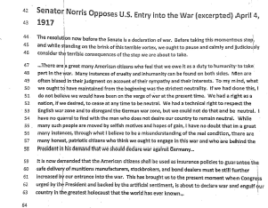
Document E Congressional Hearing
You are Senator Norris testifying before Congress. You are asking Congress for the United States to stay neutral.
Choose the strongest 2 pieces of evidence to persuade Congress to vote not to declare war on Germany.
Notes:
NOTICE—NOTE—QUESTION—Write down one detail you want to remember from Document E—Choose the two best pieces of evidence to persuade Congress not to declare war.

Slide 10
Evidence Ranking: 1-6
Read each claim.
Circle the descriptors (evidence) within each claim.
Choose the bottom 2 pieces of evidence
Choose the top 2 pieces of evidence
Rank the middle.
Always compare the evidence back to the claim.
What is most supportive?
 | With the support of many Americans who are not in favor of the United States entering the war and considering it a European affair, President Woodrow Wilson initially pledges neutrality for the United States which should be maintained throughout the war.
 | Due to Germany’s determination to win its war on attrition against the Allies, the United States congress should declare war on Germany.

Slide 11
“They Say, I Say” Argument—Should the United States Enter World War I?
The general argument made by author X in document/text/video, ________, is that_________________ (citation). More specifically, X argues that _____________ (citation). She/he write, “ ___________________. (citation)” In this passage, X is suggesting that _____________. In conlusion, X’s belief is that _______________.
This argument is wrong, because ___________. More specifically, it can be asserted that _________. For example, __________ (citation). Additionally, the evidence of _________ (citation) points to _________. Although X might object that _______ (citation), I maintain that __________. Therefore, I conclude that __________.
Notes:
They Say, I Say Argumentative Two Paragraph Counterclaim

